Slide 1

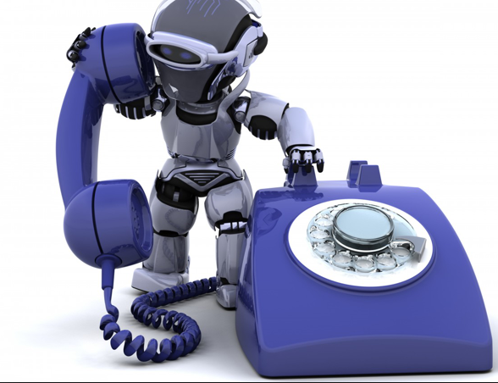

ROBOCALLS
Presented by
Seeba Sulekha Abdulkader

Slide 2
Introduction
A robocall is a phone call that uses a computerized auto dialer to deliver a pre-recorded message
Auto dialer is a computer program with VoIP connectivity featuring
Voicemail
SMS Delivery
Customizable caller ID

Slide 3
Outline
Motivation
Routing of a robocall
Key challenges
Basic techniques
Assessment Criteria
Solution
Conclusion

Slide 4
Motivation
Telephone spam costs US customers $8.6 billion annually
FTC received about 22 million complaints in 2014
Urgent need to curtail telephone spam.

Slide 5
Reasons for spike in Telecom spam
Advances in telecom led to increase in telephone spam
In US the mobile subscriber penetration rate surpassed 100%
Improved cost efficiency

Slide 6
Difference between spam calls and email spam
Spam Calls
Demand immediate attention
Deleting voice mails wastes time
May incur significant financial loss
Robocalls cannot be blocked beyond a limit
Email spam
Spam emails can be ignored
Easy to delete spam emails
Does not incur any loss
Effective email filtering possible

Slide 7
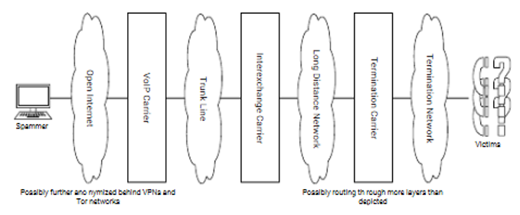
Routing of a spam call

Slide 8
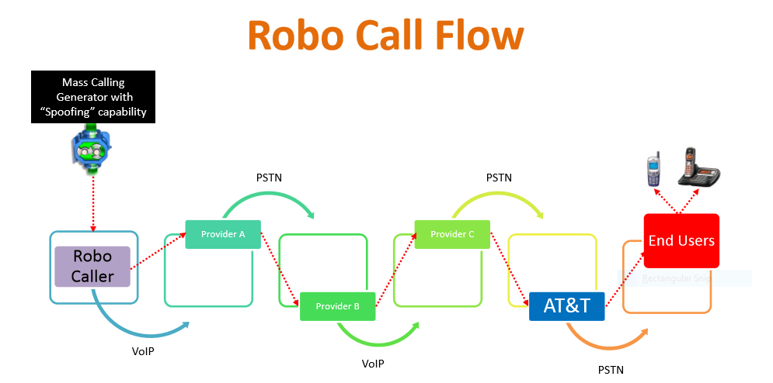


Slide 9
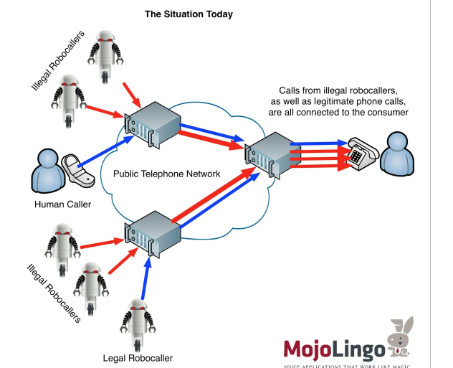


Slide 10
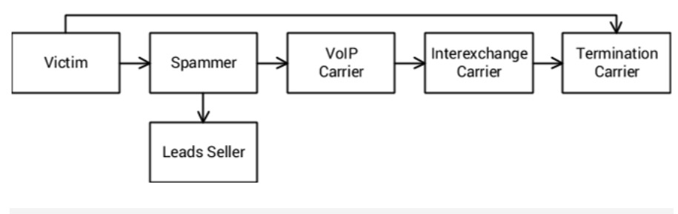
Flow of money in telecom spam system

Slide 11
Spammer Operation
Gathering numbers
Purchase from a leads seller
Downloading leak databases
Voice Spam content
Prerecorded audio stream
IVRS
Tele-marketing, political campaigns etc.
Mass Distribution Channel

Slide 12
Main tools used by spammers
Caller ID Spoofing
The practice of sending false caller ID information to the recipient that identifies the caller of a phone call.
No built-in authentication mechanism
TSP has no legal obligation
VoIP enables customizable caller ID
Voicemail Injection
Directly injects a voice message into the recipient’s voicemail for unanswered or declined calls

Slide 13
Prevalent types of scam
Credit card verification scam
Uses caller ID spoofing and duplicated audio from the IVRS of the credit card issuer.
Fake tax agent Scam
Uses caller ID spoofing
Political robocalls

Slide 14
Key Challenges
Technical challenges
Caller ID spoofing
Immediacy constraint
Difficulty with audio streams
Lack of useful Header data
Regulatory challenges
Lack of Effective Regulations
Lack of Globalized Enforcement

Slide 15
Basic Techniques to detect Tele-spam
Call Request Header Analysis
Caller ID Blacklisting
Voice Interactive Screening
Audio fingerprinting
Caller Compliance
Do not call registry

Slide 16
Assessment Criteria
Usability Criteria
No-Disturbance-to Recipient
Deployability Criteria
Negligible-changes-to-Infrastructure
Robustness Criteria
Effective-Against-Dynamic-Caller ID- spoofing

Slide 17
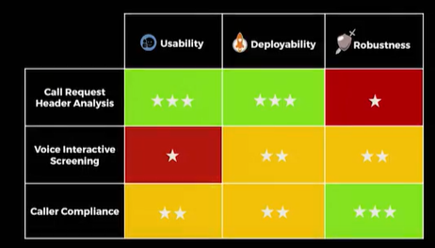

Slide 18
Effective Solution
Solution using combination of different techniques.
Three methods of combining techniques
Phased Decisions
Weighted Scoring
Conditional Procedures

Slide 19
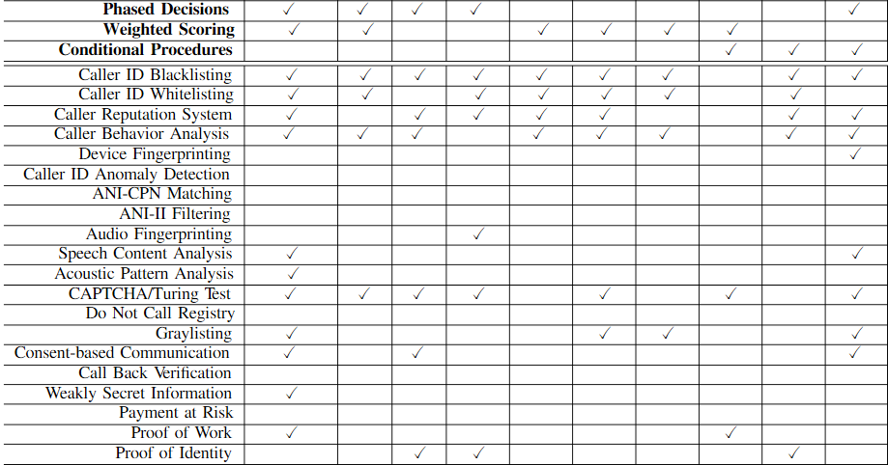

Slide 20
Speciality of the paper
First Survey paper to address spam calls in PSTN network
First to classify existing standalone techniques
First to evaluate the techniques based on three assessment criteria
First to outline the three strategies of combining standalone techniques

Slide 21
Conclusion
There is no universally acceptable solution for telephone spam
Every approach has different tradeoffs, specifically between usability, deployability and robustness
Suggests to consider usability as the main criteria in future work
Call Request header analysis would be the best solution if Caller-ID spoofing can be prevented

Slide 22
THANK YOU

